Slide 1

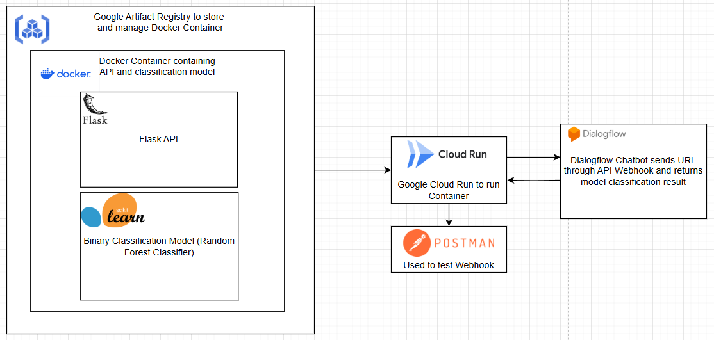
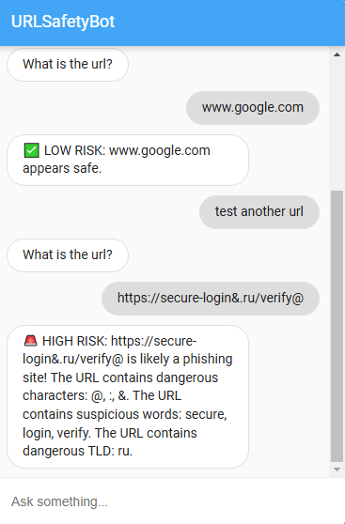
Phishing Link Detector Brendan Kenny, Brianna Cirillo, Emily Su, Kimberley Maldonado
Business Intelligence & Analytics
Introduction
The Phishing Link Detector addresses the growing need for tools to combat phishing, a leading cause of cybersecurity breaches worldwide. According to a 2023 study by the FBI's Internet Crime Complaint Center (IC3), phishing scams were the most reported type of cybercrime, with over 300,000 complaints and losses exceeding $52 million annually in the U.S. alone. Many individuals and businesses are vulnerable, as phishing emails often look legitimate, tricking even tech-savvy users into clicking malicious links. This tool not only helps users identify suspicious links but also educates them on phishing tactics, such as recognizing urgent language, unexpected attachments, or insecure URLs. By providing real-time link analysis and tips, the Phishing Link Detector empowers users to navigate the internet safely while reducing the risk of falling victim to online scams.
Architecture
Docker: Used to encapsulate the Flask API and Random Forest Classifier, providing portability and consistent deployment across environments.
Google Artifact Registry: Chosen for secure storage and efficient version management of the Docker container, enabling smooth integration with deployment pipelines.
Google Cloud Run: Enables serverless deployment, offering dynamic scaling to handle fluctuating traffic while minimizing infrastructure management.
Flask API: Serves as a lightweight and efficient interface to handle URL classification requests and return predictions.
Postman: Utilized during development for testing and debugging API responses to ensure system reliability and accuracy.
Dialogflow: Powers the chatbot interface for user-friendly interaction, connecting to the Flask API via a webhook to process and return predictions seamlessly.
Cloud Run and Dialogflow: Together enable real-time phishing detection by integrating serverless scaling with conversational AI for efficient and intuitive user interactions.
Data
The phishing URL dataset, consisting of 549,346 entries, was enriched with additional features through data parsing to enhance model accuracy. These features include URL length (total string length), number of dots, number of slashes, and the percentage of numerical characters in the URL. Binary flags were created for characteristics like dangerous characters (presence of suspicious symbols), dangerous TLDs (e.g., ".tk", ".ml"), IP address usage, suspicious keywords (e.g., "secure", "login"), repetitions (domains with repeated substrings), and redirections (URLs with "//" beyond the 7th position). Additionally, features like domain name length and entropy provided further insight into URL structure. These engineered features were inspired by research from D. Ranganayakulu and Chellappan C., as outlined in "Detecting Malicious URLs in E-mail – An Implementation" (2013).
Results
The phishing detection chatbot provides users with an interactive tool to identify potentially harmful URLs and educate them about phishing attacks. The chatbot allows users to input a URL, which is then analyzed by a trained machine learning model to determine if it is "Safe" or "Phishing." The model, trained on a dataset of over 549,000 URLs, achieves an accuracy of 85.94%, ensuring reliable results. Additionally, the chatbot offers tips to help users avoid phishing attacks and identifies suspicious keywords (e.g., "login" or "verify”), dangerous TLDs, and dangerous characters and informs the users of the higher risk. With its user-friendly interface, the chatbot empowers users to protect themselves from phishing threats by combining real-time URL analysis with educational guidance.
Conclusion
The chatbot effectively combines a user-friendly conversational interface with a robust machine learning model, achieving a reliable accuracy of 85.94% on URL classification.
Beyond detecting phishing URLs, the chatbot educates users on phishing tactics, offering actionable tips to help them avoid scams, thus empowering individuals to make informed decisions.
Enhanced Accuracy: Incorporate additional data sources, such as real-time phishing databases, to train the model with more up-to-date patterns. Use ensemble learning techniques or advanced deep learning models like transformers to improve classification accuracy.
Integration: Expand functionality with browsers, email platforms, and mobile apps.
Feedback and Updates: Implement a feedback loop where users can report incorrect classifications to continuously improve the model's accuracy and adapt to new phishing tactics.
Global Reach: Add support for multiple languages to reach a broader audience and accommodate diverse user bases globally.
http://www.stevens.edu/school-business/masters-programs/business-intelligence-analytics

